Slide 1
Lessons Learnt Developing Web Applications
Satyadeep Musuvathy
Architect, Yahoo!

Slide 2
Balance
If even one of the legs is in-correct, the stool tends to topple
Balance between System, Data and Operations
Notes:
If even one of the legs is not balanced, the stool will topple.

Slide 3
Systems
Notes:
Now let’s talk about systems

Slide 4
Systems Evolve
Design for evolution
There will always be one more “feature” ☺
Notes:
The fundamental idea is to design for “Evolution”. There will always be one more feature! ☺
Not only do systems evolve, but teams do too. You want to make it easier for new people to join in and reduce the amount of harm individual errors can bring to the system.

Slide 5
Designing For Evolution
Have clear separation of concerns
I canz do business
API, Savvy?
Your web page, Sir
Separate Web and API interaction from the business logic
Notes:
Separate the “web” part from the “business logic” for the application. Most solutions will have mechanisms for humans (Web Apps) and machines (Web-Service/API) to interact with the data. One way to test this is to see that they are running of the same implementation of business logic.
In fact, formalize the interface between the “web” part and business logic. You should be able to run them on two different machines with minor changes (say adding a marshalling layer). This will allow you to evolve each part independently as needs change. Note: you might start with both on the same machine, but unless you design it this way, difficult to scale later.
Taking this idea further, one option is to get the business layer to server out JSON or XML data and build a rich Ajax based front end on that data. GMail is a prominent example of this architecture. Look at "OData" as an emerging standard to help with this in a more formalized manner.

Slide 6

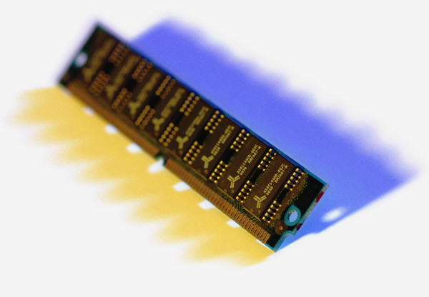
Designing For Evolution
Manage State Carefully
State A
State B
State C
“State-full”
Memory is a “scarce” resource
Web Applications are “State-full”. Worry about “OOM”
Notes:
Web applications are "statefull". Worry about the amount of information in one session. This more than anything will limit the number of "sessions" one can support concurrently on a given host. Remember most users will just close the browser instead of "logging out". This will mean that most session are reaped by timeout and hence will consume resource (read memory) long after the user has gone away.
In fact the most scarce resource you have to manage is not "CPU", but actually memory. This will mean that you could get more millage by running more "UI" centric processes in dedicated boxes with far fewer business layers servers service both the UI and API layers.
This is one of the reasons why process-per-request model systems like PHP etc., are very good, because you can run a lot of these processes on a machine and when the reques is done, you can just throw the memory away when the process dies. This also means that you will have to keep the session data in an external store and not worry about memory overhead of the same.
You can also do the external session store on Java based systems, but not the default.

Slide 7

Designing For Evolution
Aggressively differentiate sync and a-sync jobs
Vs.
Synchronous
Asynchronous
Design and scale the synchronous aspects separately from the asynchronous jobs – Not all operations need to be synchronous
Notes:
Differentiate aggressively between stuff that "has to be done now“ within the synchronous flow of a request, versus stuff that can be scheduled for later (asynchronous processing). You can then scale for just the synchronous part of the system independent of the other stuff, which can run on more dedicated batch processing stacks like Hadoop etc.
The more stuff you can do as asynchronous operations, the better you can scale your infrastructure and the higher will be the utilization for the same.
Synchronous traffic is highly spiky, and you want to scale a smaller set of hardware for this as opposed to the rest of the system.

Slide 8
Data

Slide 9
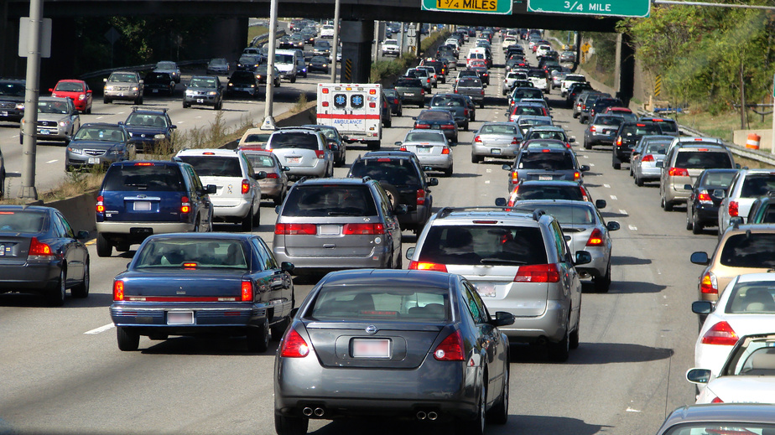
Application Data
Most Systems are I/O bound
In most cases I/O throughput defines “perceived” performance
Notes:
Next to memory, the next scarce resource is I/O bandwidth. In fact a major part of "perceived" application performance is I/O throughput. Define your data flows accordingly.
Small things like compressing the data between the web-app and the browser will have drastic impact on perceived performance of your application.
This also means that it is cheaper to perform more computation closer to the data and then forward the smaller result sets for upstream processing that sending more data up and trying to filter or compute at the front-end server layer.

Slide 10

Application Data
Make data “Shardable”
“Shardable” data will allow you to scale out your data demands as the application grows.
Notes:
Design your databases so that it is 'shardable'. You don't have to do this from day 1, but unless you plan for it, very difficult to do later. This will become important as your data starts outgrowing capabilities of a single instance.
This will also allow you to scale the data layer independent of the other layers in the stack.
Worry about your index behavior at the database level. Database systems like oracle etc will dynamically change the query plans based on the perceived load. This can really bite you unless you look out for it. Typical solutions involve either adding addition index's or hints to your queries to pick the correct set of indexes. This will especially happen on complex join related queries.

Slide 11


Application Data
Consider multiple stores for data
Grid
Database
“Divide and Conquer”
Consider shipping copy of the data to Grid or dedicated machines for batch or “secondary” tasks.
Notes:
Think of possibilities of having different stores of data for different needs. For example, you might have your code information in an RDBMS database, but for large analysis or batch jobs, it might be cheaper to ship a 'flattened' copy over to a hadoop cluster to process it rather than loading the database.
On the same note, If you have multiple kinds of applications working on related data sets, see if you can partition the processing across clusters of database servers. Only makes sense if you have huge data sets being worked on.

Slide 12
Operations
Notes:
This is frequently under-rated, but unless you have an idea of how your current system is behaving, it will be very difficult to know what parts needs scaling or are under performing.

Slide 13

Operations
Utilization is very spiky
Plan for peak loads, but try to distribute processing over time
to minimize over-provisioning.
Notes:
Remember, traffic usage patterns are very spiky. It is not uncommon for the high's to be 10x or more than the normal. You need to plan for the high's. But if you just plan for 10x hardware across the board this will be very in-efficient. This is why you need to plan for scaling each layer independently to get better return on investment.
For example, you might notice that there are certain days in your week or certain weeks in a month when the usage is really high. You might want to plan your data intensive operations around these times so as to better spread the load on your data and business logic layers.

Slide 14
Operations
Constantly monitor systems
Constantly monitor the system for CPU, Memory, Disk and I/O
Have system “raise” events for critical issues rather then parsing log files.
Notes:
Have mechanism to look at CPU, I/O, disk space, memory utilization etc. Far cheaper to act to changes if you have an idea of your growth and usage profile rather than react on every outage.

Slide 15




Operations
Have a failover plan
Plan and “TEST” backup systems.
Look for and prevent domino effects of failure
Notes:
A good failover mechanism is your friend. Have a failover process and test it! An untested failover is not a failover :-)

Slide 16

Q & A
Thank You!

